Slide 1

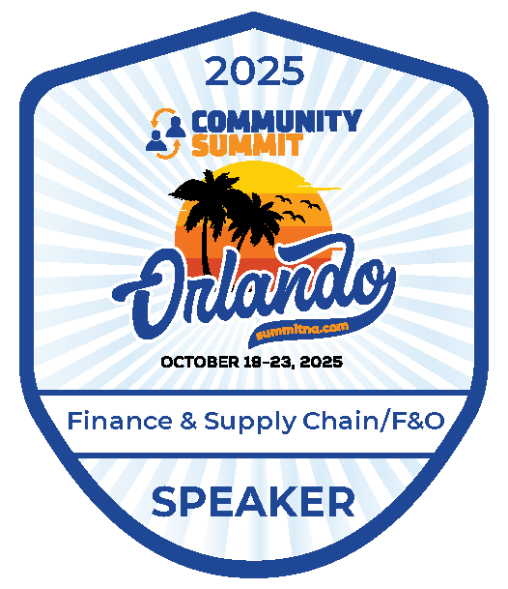
FINANCE &
SUPPLY CHAIN/F&O
Orlando, FL
October 19-23, 2025

Slide 2
The Fast & The Data-Migrated: Speeding Through F&O Data Migrations Without Crashing

Slide 3


Nathan Clouse
Sr. Director, D365 Solutions
WineShipping
6x MVP
atomicax.com
dynamics.fo
Nathan.clouse@gmail.com

Slide 4
Start Your Engines
  What is data migration
Building Your Racecar
  Intro
Turbocharging Performance
  Misc Learnings over the years
  Precision Steering
    Mapping tips and tricks
  Avoiding the Wreck
    Troubleshooting
Automation and Scaling
“It does what I want but I want it to go faster”

Slide 5
Start Your Engines
DMF
Data migration
Integration
Power BI
Configurations
Apps
Automation
Reporting
Excel
Why migration is more than a one-time task — it’s a performance-critical project.
Go-Live formula:
Configs + Data Migration = Production

Slide 6
Import / Export / Copy
Export / Import / Copy into legal entity
Templates
Filter
Mapping
Add criteria
Remove map for entity field(s)
Data Management
Import / Export
Data Projects
Job History
Configure entity to export to database /BYOD /Change tracking(Primary, Entire, Custom)
Recurring integrations
Sequencing
Data entities with a data package
Default
Custom
Golden Config
Module
Priority
Data Entities
Template
Dual-write

Slide 7
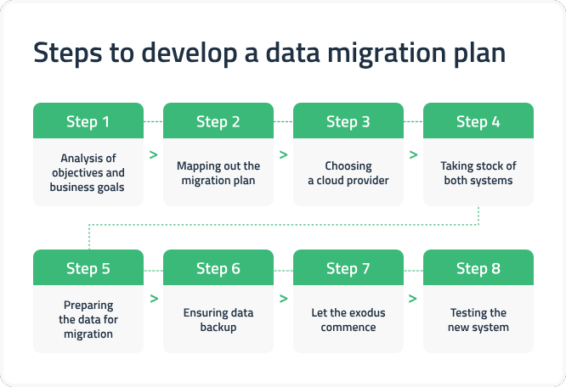
Key migration phases: planning - when
Staging - how
Transformation - where
Validation - what
Go-live - who
(This is not a complete list)

Slide 8

https://www.youtube.com/watch?v=cDA3_5982h8

Slide 9
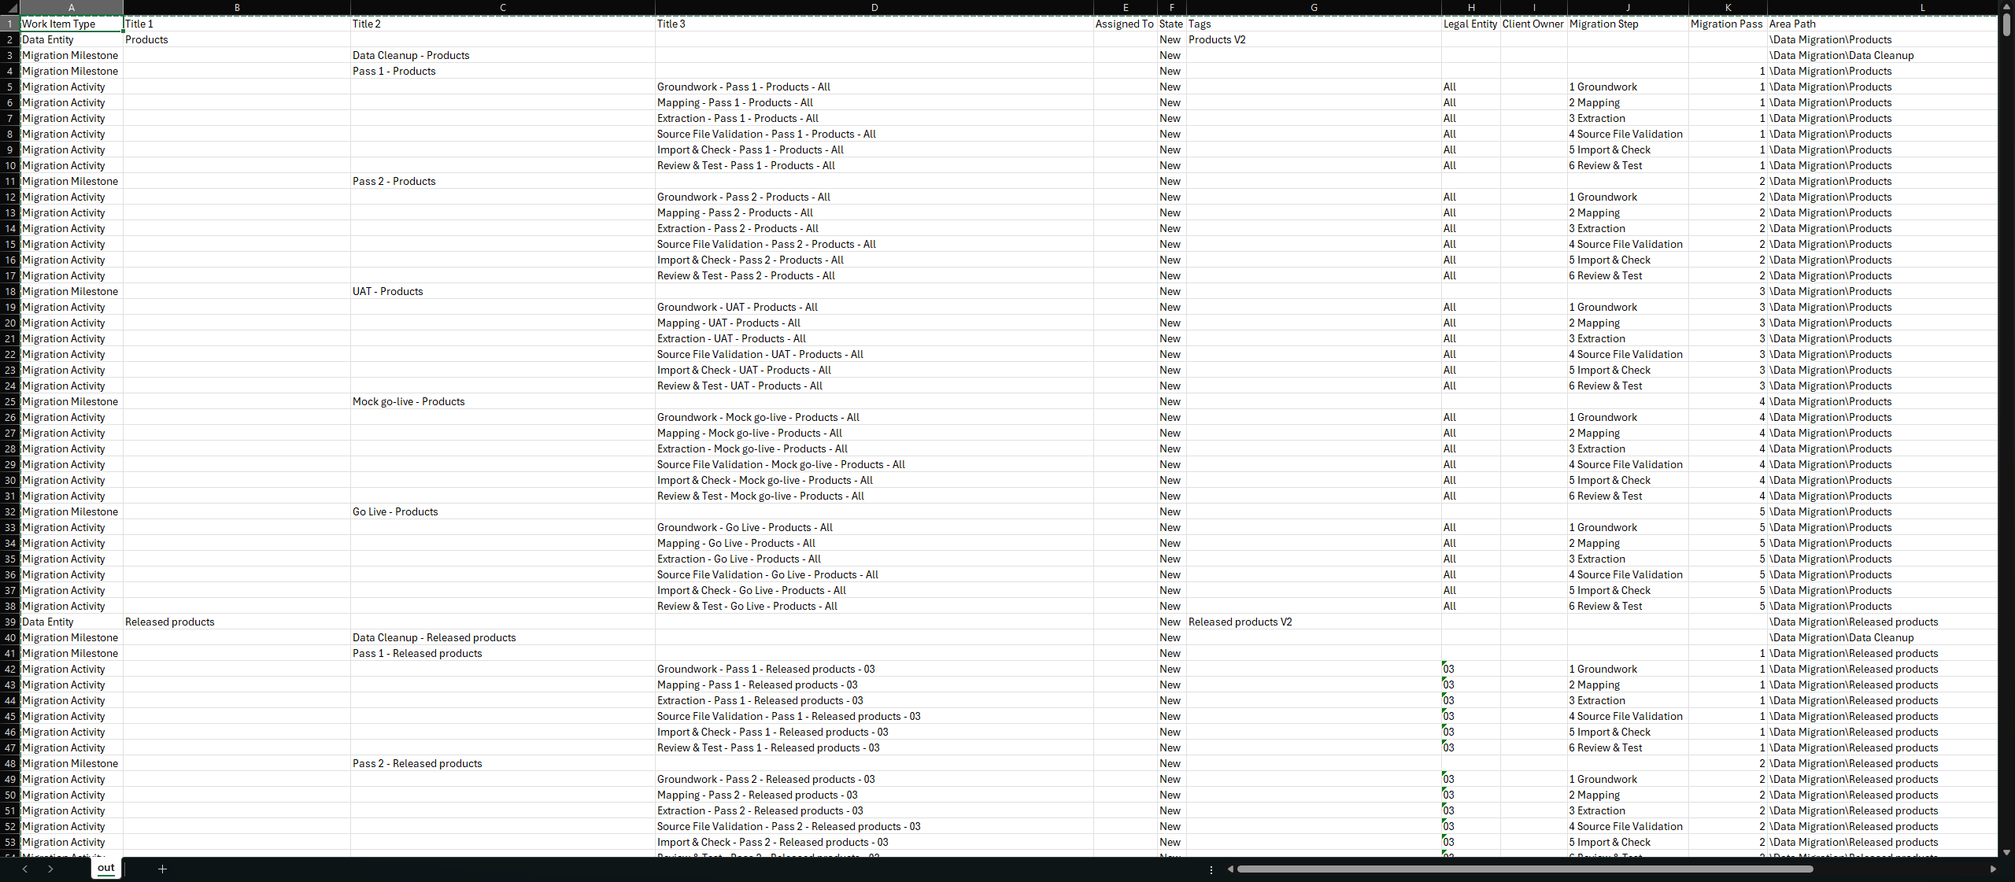
Notes:
https://github.com/NathanClouseAX/CommunityPresentations/blob/master/2025/Data%20Migration%20Creator.py

Slide 10

Building the Racecar
Anatomy of a data project: entities, data packages, and project configurations.
Import vs. export strategies and when to use each.
Tips for setting up a “clean track”: prerequisites, templates, and environment prep.

Slide 11
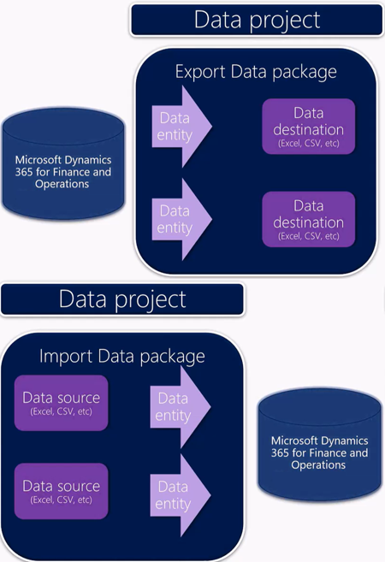
Building the Racecar
Overview of DMF
Data entities
Data package
Data project

Slide 12
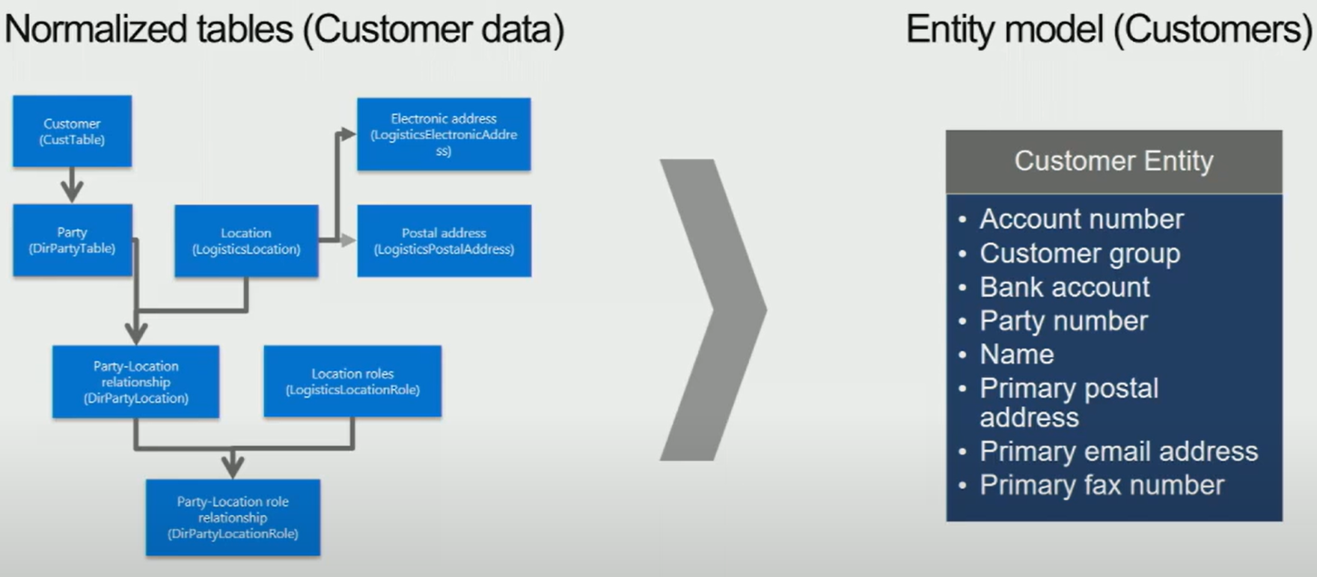
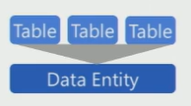
Data Entity

Slide 13
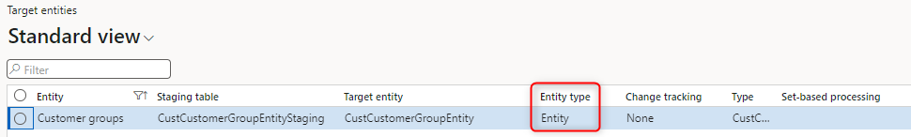
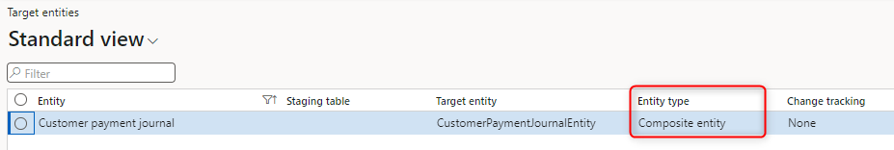
Entity Types

Slide 14
Strategies
DMF
Data migration
Integration
Power BI
Configurations
Apps
Automation
Reporting
Excel
Composite vs Standard
Excel Add-in
Integration? Automation?

Slide 15

Tips for setting up a “clean track”
Prerequisites
Templates
Environment prep.

Slide 16

Prerequisites
Plan
Know what data are being migrated
Know where to get those data
Know how to get the data available
Where is activity going to take place?
“Trust but verify”

Slide 17
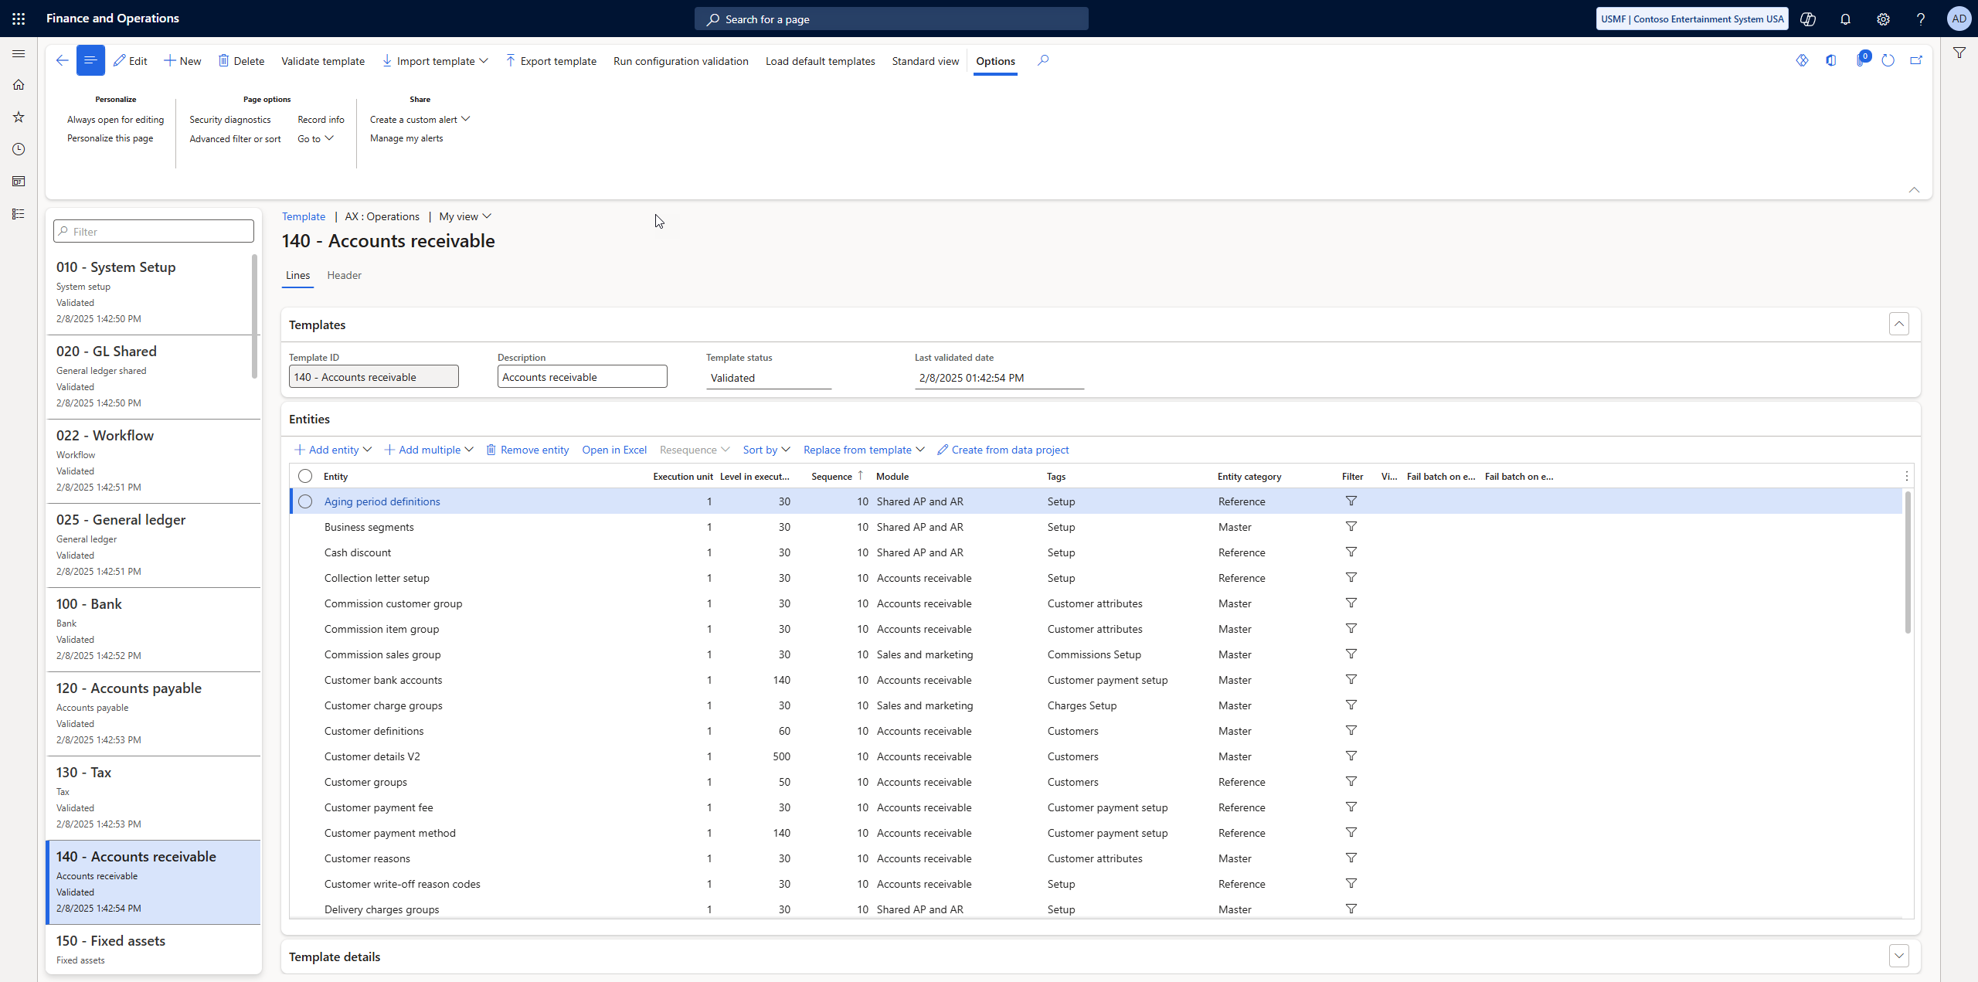
Templates
MSFT provides templates to get started
Not always up to date but a great place to start

Slide 19
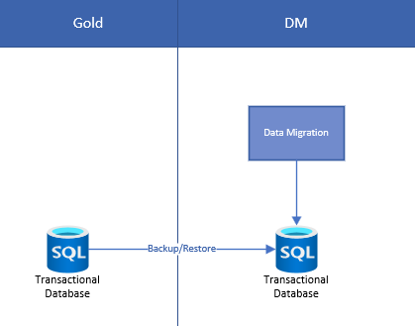
Environment Preparation
Golden > DM environment
Make one-time changes for DM (from list)
Import data
Undo one-time changes
Test

Slide 20
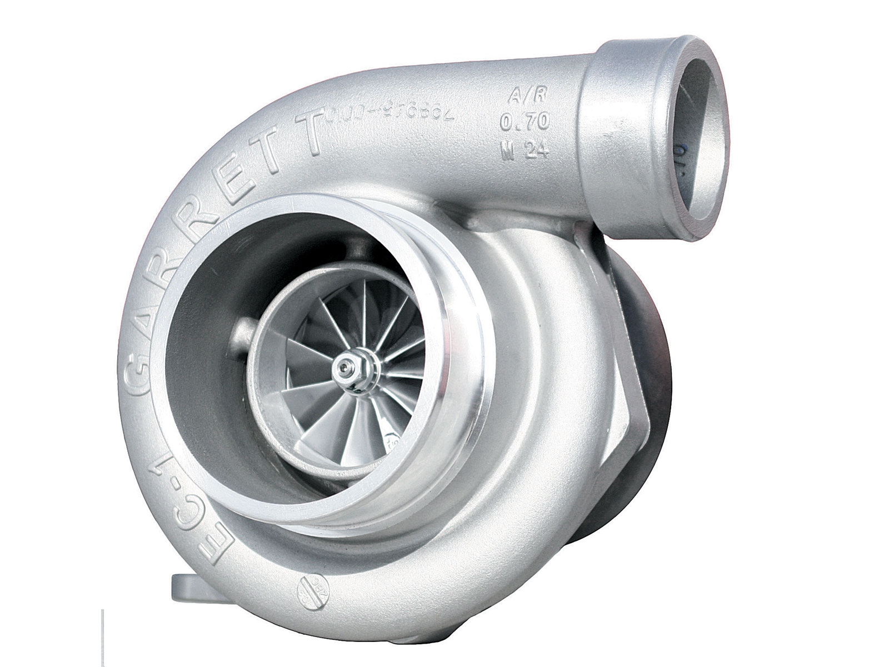
Turbocharging Performance
Optimizing data entity performance: parallel processing, and batching.
Best practices for handling massive datasets without spinning out.

Slide 21
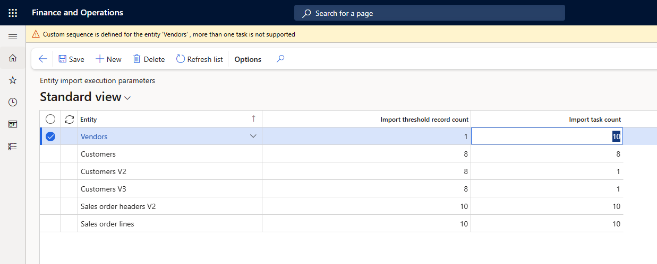
Optimizing Support
System Administration > Framework parameters > Entity Settings (tab)> Configure Entity Execution Parameters

Slide 23
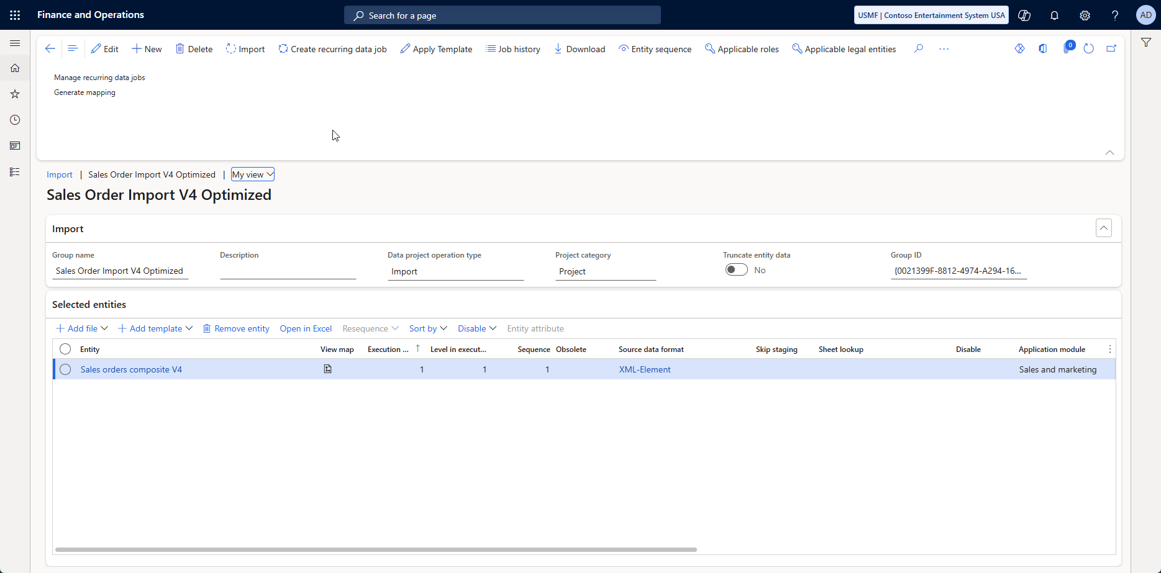

Slide 24
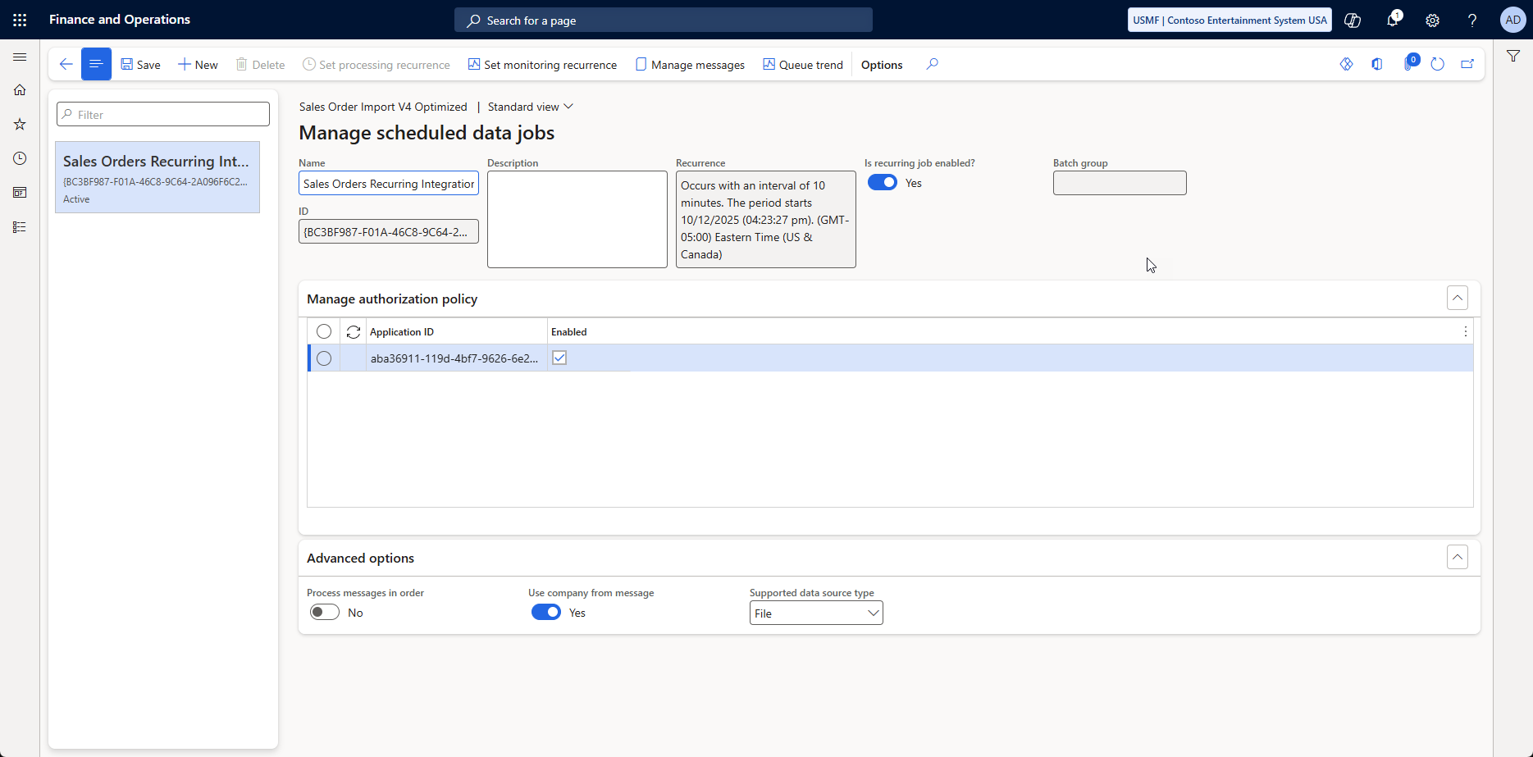

Slide 25
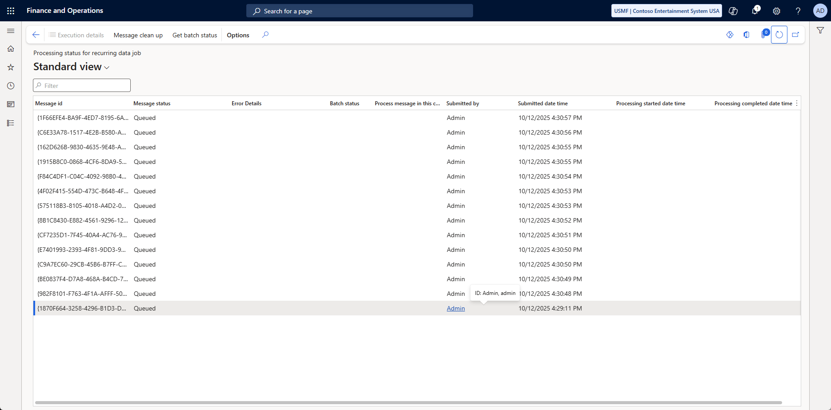

Slide 26


Slide 27
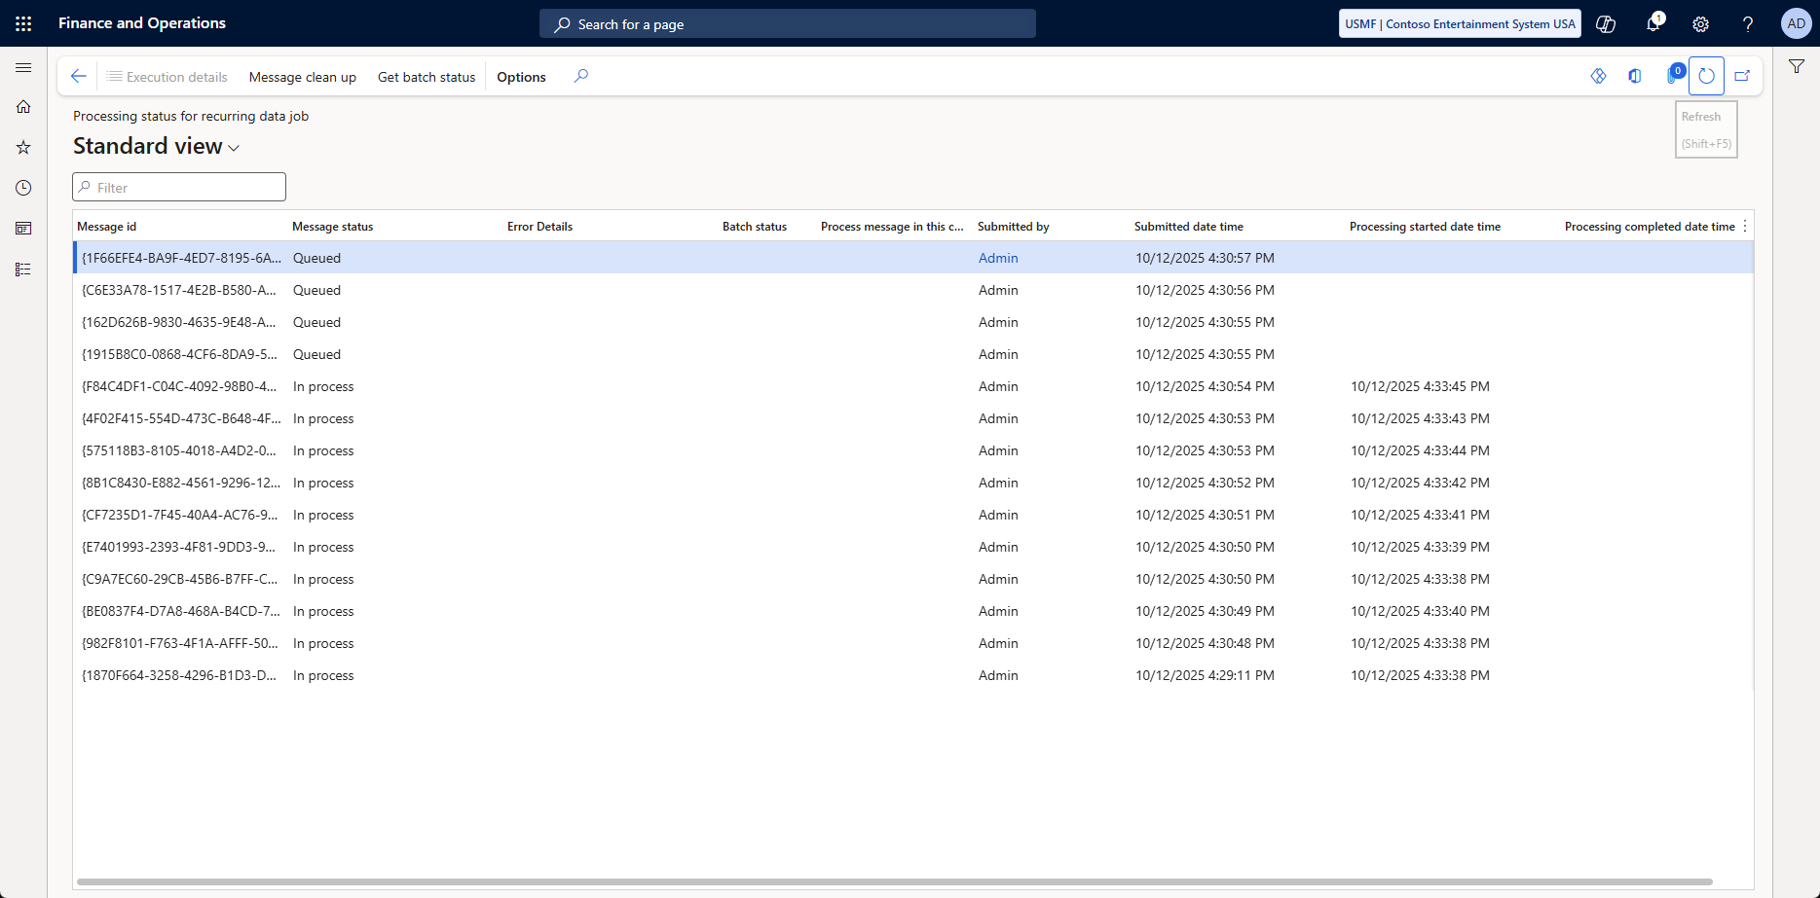

Slide 28
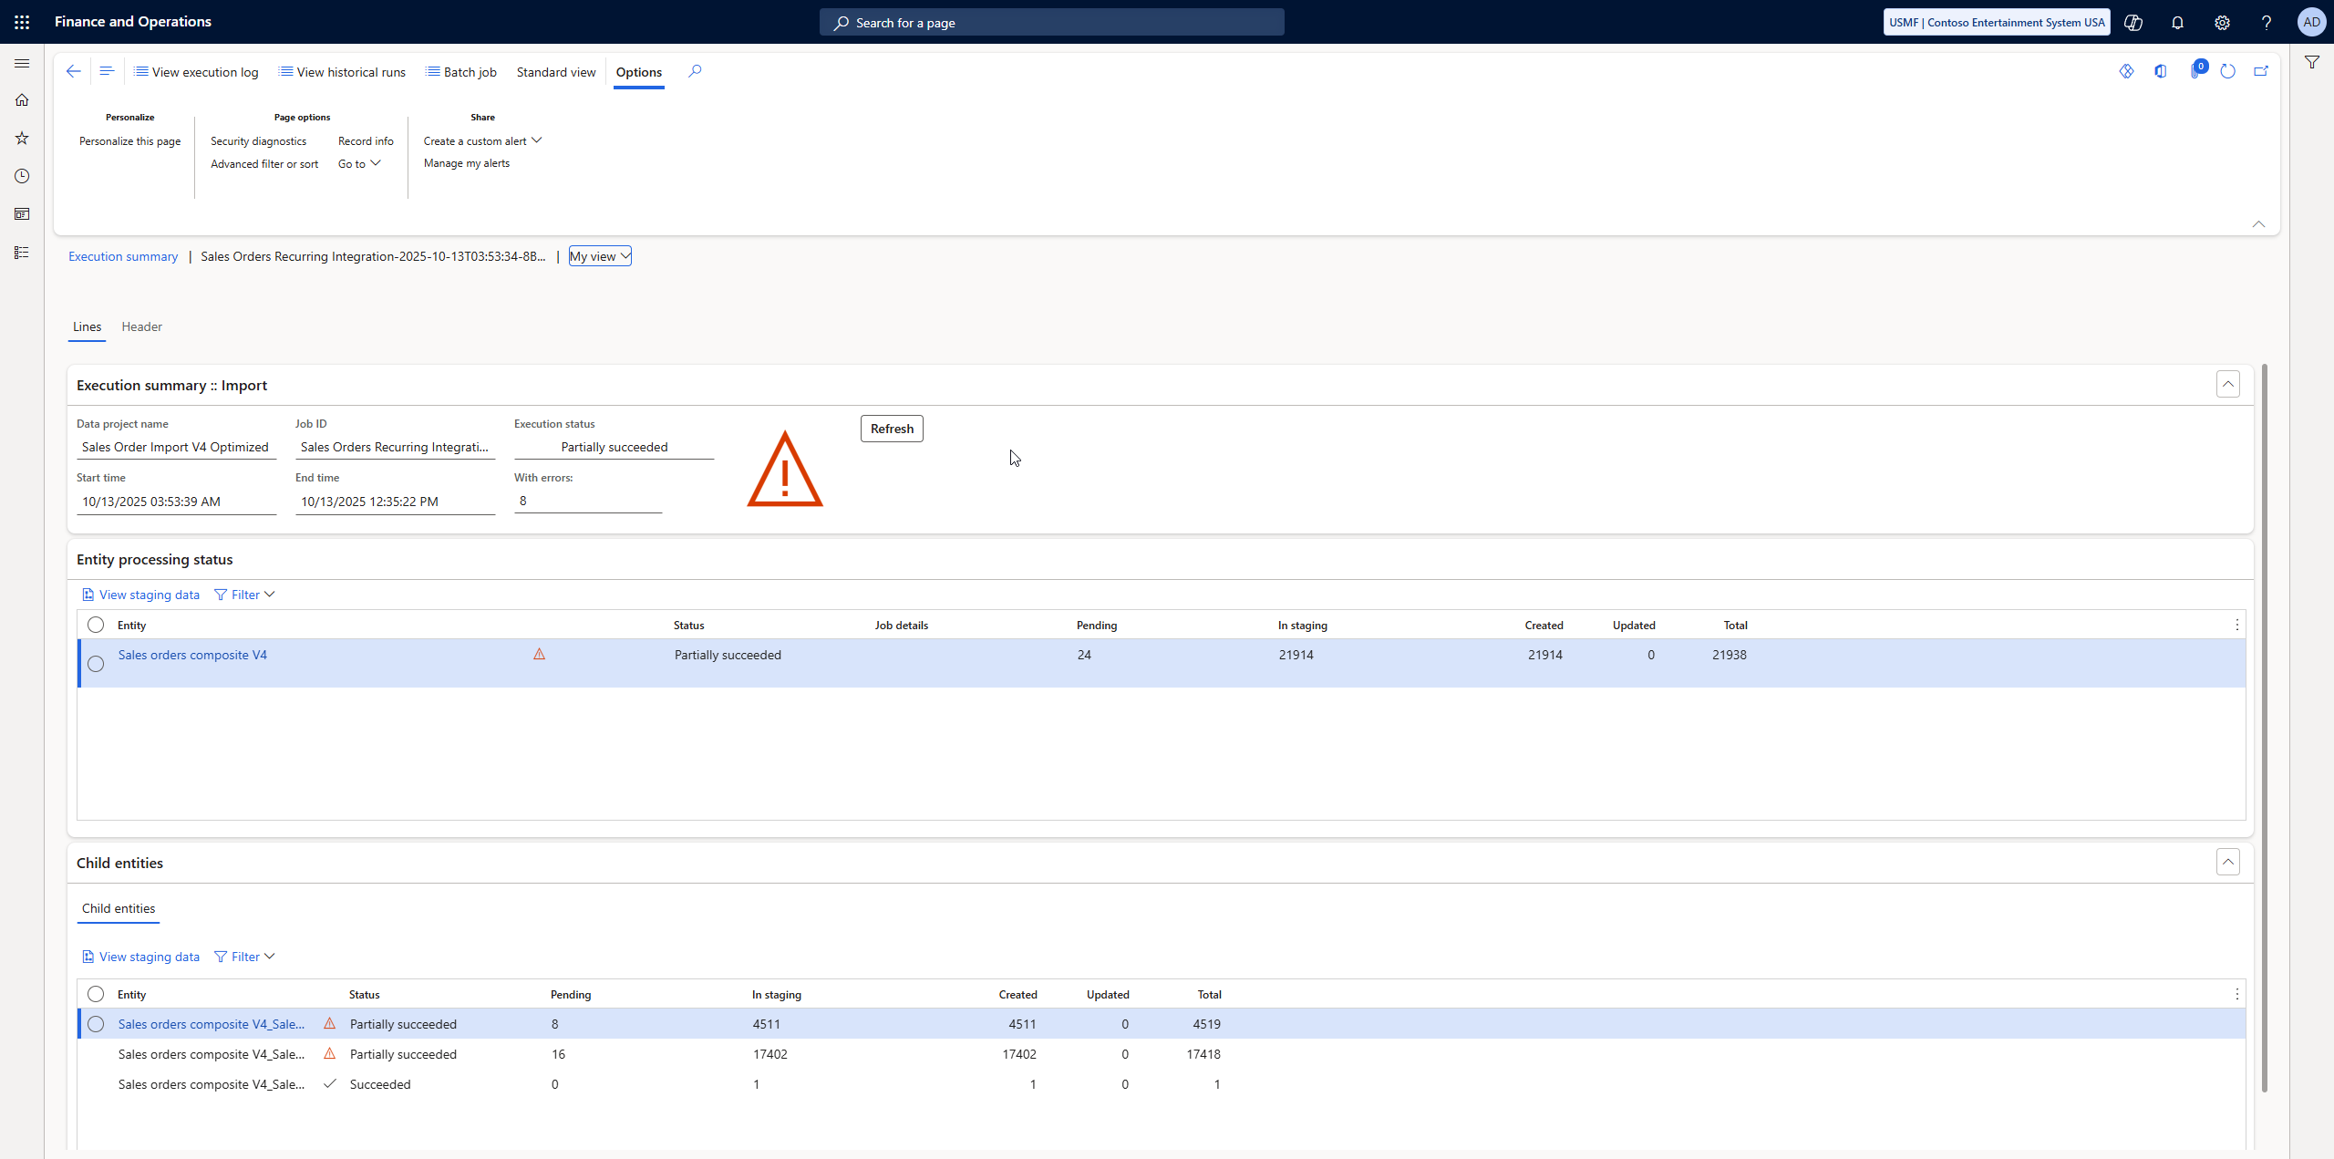

Slide 29

Precision Steering
Custom mapping approaches for complex transformations.
Automating migration workflows with PowerShell, Logic Apps, or Azure Data Factory.
How to validate and reconcile data with minimal manual effort.

Slide 30

Mapping
Match F&O mapping
Get export for what you want
Build import from that export

Slide 31

Automating
(could be its own session)
Use PowerShell, Power Automation, Azure Data Factory or SSIS, etc.
Build a data pipeline: Extract, Transform, Load (ETL)

Slide 32

Data Validation
Referential Integrity is handling during import
While working through data, use an “error” value if unknown
Rules will fail so plan ahead

Slide 33

Avoiding the Wreck
DMF can be slow so plan ahead
Build to a time budget
  Get data in correctly
  Get data in within time budget
Plan and build for scale
Pre-allocate primary keys if you can (for orchestration)

Slide 34

Misc Things I’ve Learned

Slide 35
Lesson’s Learned
Empty is not the same as not there
If you don’t need it, don’t include it
If you’re unsure, don’t include it
“Auto Generate Keys” settings
Technical: use “resolution methods” if you need to
  https://github.com/NathanClouseAX/AAXDataEntities/blob/master/AAX%20Data%20Entities/AxDataEntityView/AAXCustomerContactInfoEntity.xml#L52

Slide 36
More Lesions Earned
Excel break your data
“orchestrate your data”
  Use Execution Unit, Level in Execution Unit, Sequence
Setup DMF telemetry
Check out “Data Management Workspace: The most common user errors and mistakes” and “Navigating ERP Migration: Strategies for Seamless Data Transition to Dynamics 365”

Slide 37
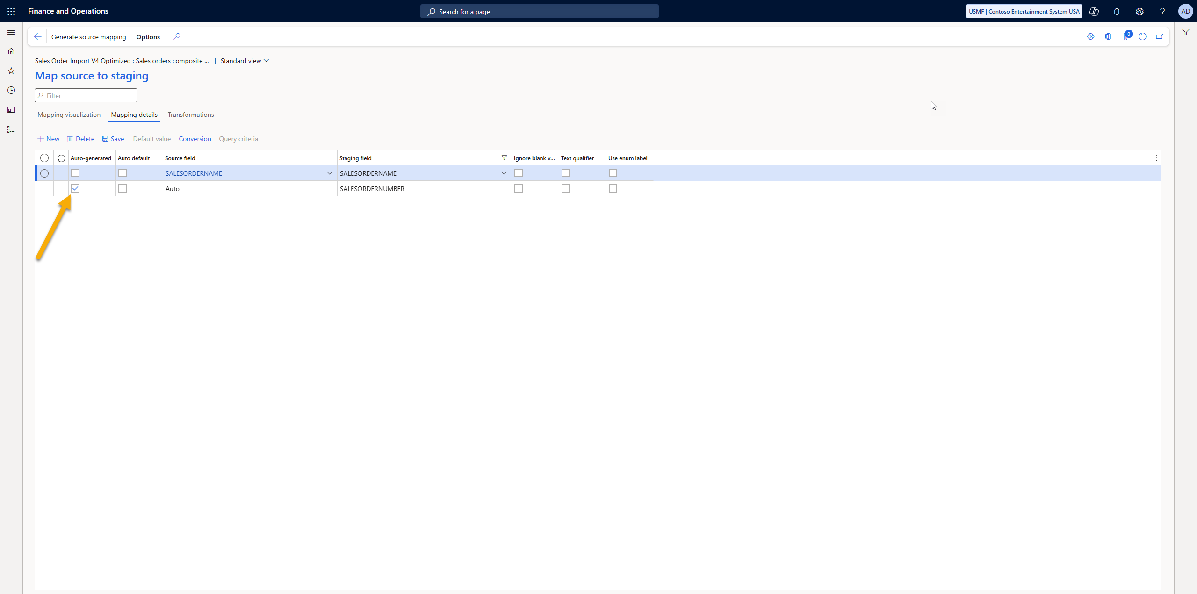

Slide 38
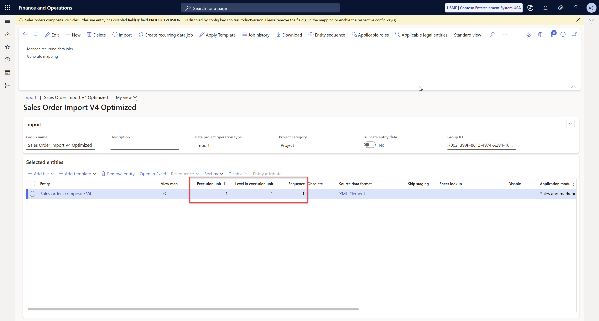

Slide 39
Troubleshooting

Slide 40
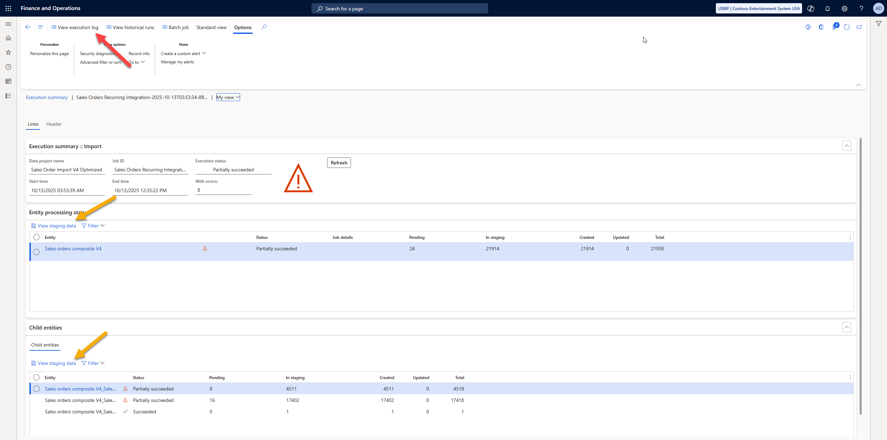

Slide 41
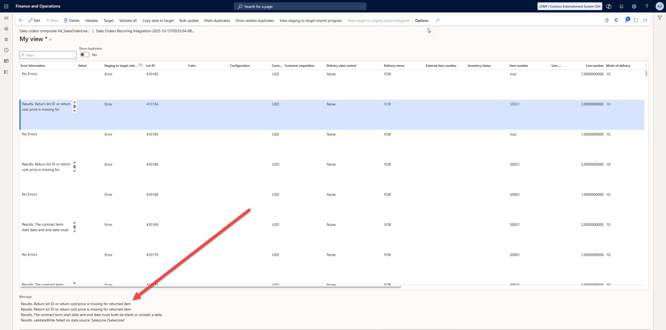

Slide 42

Crossing the Finish Line
Compare counts between source and target
Verify data points – export from F&O and compare
Loaded is not tested – run transactions against data
Others?

Slide 43
Take Aways
Create an extensive plan
Export -> Import map
Create pipelines using those mappings
Test, Test, Test
Can data migration be an integration?

Slide 44
Questions?

Slide 45
Suggested Resources
https://www.linkedin.com/pulse/61-useful-tips-d365-finance-operations-peter-k--sjmne/
https://stoneridgesoftware.com/d365-finance-and-operations-13-key-tips-to-elevate-your-distribution-operations/
https://www.linkedin.com/pulse/practical-guide-data-management-framework-dmf-a9q4f/
https://www.linkedin.com/pulse/practical-guide-data-management-framework-dmf-a9q4f/
https://www.randgroup.com/insights/tip-of-the-month/finance-operations-totm/d365-fo-tip-of-the-month-mass-updates-with-edit-in-bulk-feature/

